Slide 1
Employee Data Analysis using Excel
STUDENT NAME: PAVITHRA M
REGISTER NO: 312208548
DEPARTMENT:B.COM[GENERAL]
COLLEGE : CHELLAMMAL WOMENS COLLEGE, GUINDY, CHENNAI

Slide 2
PROJECT TITLE
EMPLOYEES PERFORMANCE ANALYSIS OF EACH DEPARTMENT SALARY.

Slide 3


AGENDA
Problem Statement
Project Overview
End Users
Our Solution and Proposition
Dataset Description
Modelling Approach
Results and Discussion
Conclusion
3/21/2024 Annual Review

Slide 4

PROBLEM STATEMENT To assess and understand the relationship between employee performance and salary distribution within each department of the organization. The analysis aims to identify patterns, discrepancies, and areas for improvement to ensure equitable compensation practices and to support informed decision-making in talent management. he organization operates with multiple departments, each contributing to the overall success of the company. Employee performance and compensation are crucial elements that impact employee satisfaction, retention, and productivity. However, there is a need to systematically analyze these factors to ensure alignment with organizational goals and fair compensation practices.

Slide 5

PROJECT OVERVIEW
This project aims to analyze employee performance and salary data across various departments within the organization to understand the relationship between performance metrics and compensation. The goal is to ensure fair and equitable salary distribution, optimize compensation practices, and provide insights that can inform talent management strategies. The project aims to conduct a comprehensive analysis of employee performance and salary distribution across various departments within the organization. By examining performance metrics such as reviews and key performance indicators alongside salary data, the project seeks to identify correlations between employee performance and compensation levels.

Slide 6

WHO ARE THE END USERS? The end users of the employee performance and salary analysis are primarily the Human Resources (HR) department, department heads, senior management, the finance team, and compensation specialists. HR utilizes the analysis to ensure equitable compensation practices and refine performance management processes. Department heads rely on the insights to manage their teams more effectively and address any compensation related issues. Senior management uses the findings to make strategic decisions regarding overall compensation policies and organizational effectiveness. The finance team integrates these insights into budget planning and financial forecasting. Compensation specialists use the data to develop and implement fair and competitive salary structures

Slide 7

OUR SOLUTION AND ITS VALUE PROPOSITION
FILTERING : Help one eliminate unnecessary data.
CONDITIONAL FORMATING: Makes it easy to highlight Certain values or to make particular cells easy to identify.
PIVOT TABLE :We separate gender types in column table with the helps of pivot table analysis report.
FORMULA : Sum Function in excel is useful for adding up a range of value such as a column or row of numbers.
BAR GRAPH – Final report with the help of pivot table analysis

Slide 8
DATASET DESCRIPTION
EMPLOYEE DATA SET- NAN MUDHALVAN PROTAL9
FEATURE IN TOTAL3 FEATURE BEING USING FOR
ANALYSIS EMPLOYEE ID- ALPHANUMERIC(TEXT)
NAME ALPHABETICAL (TEXT) GENDER ALPHABETICAL(TEXT)DEPARTMENT-ALPHABETICAL(TEXT)SALARY- NUMERICALSTART
DATE ALPHABETICAL(TEXT)FIT- NUMERICALSTART
DATE ALPHABETICAL (TEXT)EMPLOYEE LOCATION ALPHABETICAL(TEXT)

Slide 9

THE "WOW" IN OUR SOLUTION
The "wow" factor in our solution lies in its transformative impact on organizational fairness and strategic decision-making. By offering a data-driven approach to analyze the intricate relationship between employee performance and salary across departments, our solution unveils hidden patterns and discrepancies that may otherwise go unnoticed. The use of advanced analytics and intuitive visualizations empowers decision-makers with actionable insights, leading to a profound enhancement in compensation equity and alignment. This results in a more motivated and satisfied workforce, as employees perceive greater transparency and fairness in how their performance is rewarded
3/21/2024 Annual Review
9

Slide 10
MODELLING
STEP-1 : DOWNLOAD THE EMPLOYEE DATASET IN NAN MUDHALVAN PORTAL AND OPEN THE EXCEL.
STEP-2 : SELECT THE DATA AND CLICK ON FILTER OPTION. STEP-3 : FILTER FTP IN ASSCENDING ORDER(A TO Z).
STEP-4 : SELECT THE ENTER DATA AND CLICK ON INSERT AND CLICK ON PIVOT TO CREATE PIVOT TABLE.
STEP-5 : DRAG THE NEED DATA AND CREAT A PIVOT TABLE. STEP-6 : SELECT THE PIVOT TABLE, CLICK ON INSERT – CHOOSE THE TYPE OF CHART ACCORDING TO ONE’S REQUIREMENT. TYPE OF CHART USED IN THIS ANALYSIS IS BAR DIAGRAM.
STEP-7 : THE TABLE AND CHART IS BEING CREATED , WHICH HELPS IN BETTER UNDERSTANDING AND INTERPRETATION OF DATA.
10

Slide 11
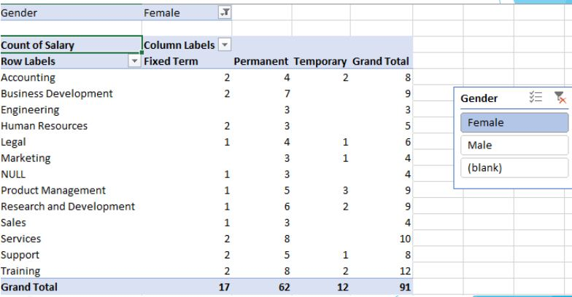
RESULTS
1. TABLE

Slide 12
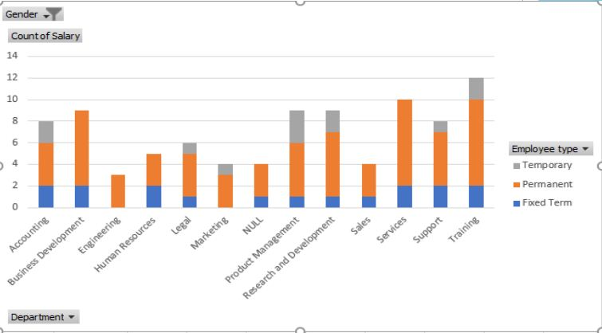
2.BAR DIAGRAM
12

Slide 13
Conclusion
In conclusion, our employee performance and salary analysis provides invaluable insights into the alignment between performance and compensation across departments. By identifying disparities and patterns, we offer a clear path toward achieving fair and equitable compensation practices. This not only enhances transparency and trust within the organization but also optimizes talent management and financial planning. As a result, the solution fosters a more motivated and satisfied workforce, aligns compensation with individual contributions, and supports strategic decision-making, ultimately driving both organizational effectiveness and employee engagement. Furthermore, the findings enable informed decision-making for HR, management, and finance teams, contributing to more strategic compensation practices and effective budget management

